Slide 1
Introductory training
[Qualification name, syllabus title and code (in brackets)]
Day 2
[If you are writing IGCSE courses, please add both codes for A*-E and 9-1 e.g. IGCSE™ Computer Science (0478/0984). Do not include O-levels]

Slide 2
Session 1
Welcome back and outline of the day

Slide 3
Outline for the day
Today we will consider the following:
how learners are assessed in this syllabus
how to use assessment materials to inform your teaching
medium- and short-term planning
how to prepare for assessments

Slide 4
Session 2 – assessment
The objective of this session is to ensure that you understand how learners are assessed in this syllabus

Slide 5
Activity 6 – marking candidate scripts
Mark the scripts in accordance with the mark scheme provided

Slide 6
Feedback on marking
We are now going to go through some feedback for the marking activity
You will need to refer to the marking feedback handout to do this

Slide 7
Break
Please be back in 20 minutes
Refreshments are available

Slide 8
Session 3 – using assessment materials
The objective of this session is to consider how you can use assessment materials to inform your teaching

Slide 9
Activity 7 – analysing reports
Read the key messages from the Principal Examiner’s Report
List any points which may inform your teaching or would be useful to pass on to your learners
Be prepared to share your ideas

Slide 10
Activity 8 – past paper materials
Discuss ways in which you could use past paper materials in your classroom

Slide 11
Possible uses of assessment materials
Lesson starter – then revisit as a plenary
Group work for learners:
  build a model answer
  create a mark scheme
  identify common errors from Principal Examiner’s Reports
Use for formative or summative purposes

Slide 12
Assessment types
Initial – establishes the baseline of current knowledge
Formative – informs both teacher and learner of progress during the course
Summative – summarises and proves the learning at the end of the topic or course

Slide 13
Lunch
Please be back in 1 hour

Slide 14
Session 4 – long-term planning
The objective of this session is to help you decide upon a teaching order for the syllabus

Slide 15
Activity 9 – interdependent units
Use the syllabus document to identify examples of interdependent areas
Be prepared to share your findings with other participants

Slide 16
Planning lessons – structure
Aims
Learning Objectives – these must be shared with learners
Starter, main and plenary if appropriate
Differentiation
Assessment – initial, formative and summative

Slide 17
Break
Please be back in 20 minutes
Refreshments are available

Slide 18
Session 5 – planning your teaching
The objective of this session is to give you the opportunity to plan using the ideas and resources we have discussed during the course

Slide 19
Activity 10 – planning exercise
You will use the ideas seen during the previous sessions to plan a lesson in detail
Pack writer: You may wish to be specific about the area of the syllabus you want participants to focus on. If so, include this here

Slide 20
Session 6 – preparing for assessment
The objective of this session is to understand how to prepare for assessments, including:
  advice to teachers
  revision strategies
  approaches to the examination

Slide 21
Advice to teachers
Check that you are teaching the correct syllabus for the year of the assessment and that all content is covered even if it has not been tested recently
Check that the module combination is valid
Check what learners are permitted and not permitted to take into the assessment and practise assessments under these conditions

Slide 22
General advice for learners
Read the rubric carefully
Allocate time to questions sensibly – minutes per mark?
Rough work/planning can be on the bottom of the same page as your answer. Do not cross it out but label it clearly
Write clearly – the examiner needs to be able to read it
You can answer questions in any order – do the ones you can do best first then do the rest
Check that you haven’t missed any questions
Show clarity of thought and steps in an argument clearly

Slide 23
Specific advice for learners of XXXX
Give some key points that learners need to bear in mind

Slide 24
What makes a good answer?
Give examples/key points for your syllabus of what makes a good answer

Slide 25
























Teaching and learning resources
http://www.cambridgeinternational.org/teaching-and-learning/

Slide 26




Professional Development Qualifications (PDQs)
  http://www.cambridgeinternational.org/pdq

Slide 27
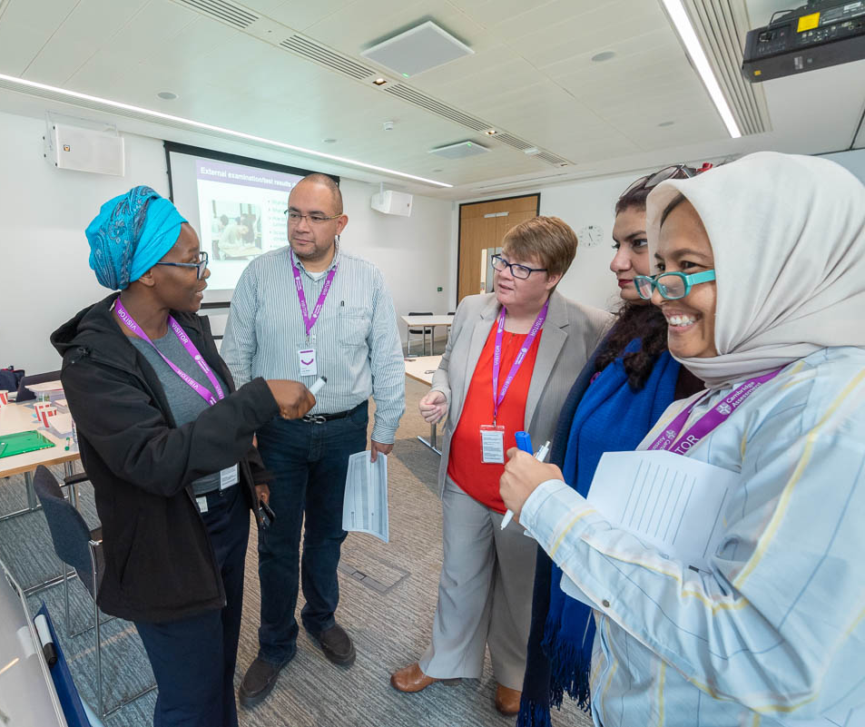
Become a Cambridge trainer
Are you?
Full of good teaching ideas to share with other teachers?
An engaging presenter and facilitator?
Confident in your subject area and in teaching Cambridge programmes and qualifications?
Always developing your own teaching skills?
Well organised and capable of meeting deadlines?
If yes, we are looking for people like you to become teacher trainers for Cambridge International. For more information, visit
www.cambridgeinternational.org/cambridge-for/trainers/

Slide 28

Other opportunities with Cambridge
Want to work with Cambridge?
Help produce high quality teaching and learning resources for Cambridge upper secondary and advanced programmes.
Reach the international community with your experience and enthusiasm
Share your teaching approaches and activities to help build teacher confidence around the world.
To become a teacher consultant visit:
http://www.cambridgeinternational.org/cambridge-for/teachers/teacherconsultants/

Slide 29

How to keep in touch
Email
  info@cambridgeinternational.org
Future training events
  www.cambridgeinternational.org/events
Facebook
  www.facebook.com/Cambridgeint
LinkedIn
  linkedin.com/company/cambridgeinternational
Twitter
  @Cambridgeint
  #cambridgetraining

Slide 30
Summary
Over the two days we have covered the following areas:
the syllabus and its requirements
teaching approaches
formative assessment
the assessment process
the use of assessment materials in the classroom

Slide 31
Plenary
Have all your questions been addressed?
Are there any questions that still need answers?

Slide 32
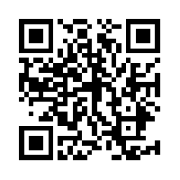
Feedback
Please fill in the feedback form provided using the link http://www.cambridgeinternational.org/f2ffeedback
We value your feedback and use it to improve our products and our training

Slide 33
End of day 2
Thank you for taking part in today’s training.
Please stay behind now if you have any further questions.

