Slide 1
Introductory training
[Qualification name, syllabus title and code (in brackets)]
Day 1
[If you are writing IGCSE courses, please add both codes for A*-E and 9-1 e.g. IGCSE™ Computer Science (0478/0984). Do not include O-levels]

Slide 2
Session 1
Welcome and outline of the day

Slide 3


Housekeeping and general points
Health and safety
Fire safety – alarms and exits
Washrooms
Refreshments
Mobile telephones
Pack contents

Slide 4

Welcome and introductions

Slide 5
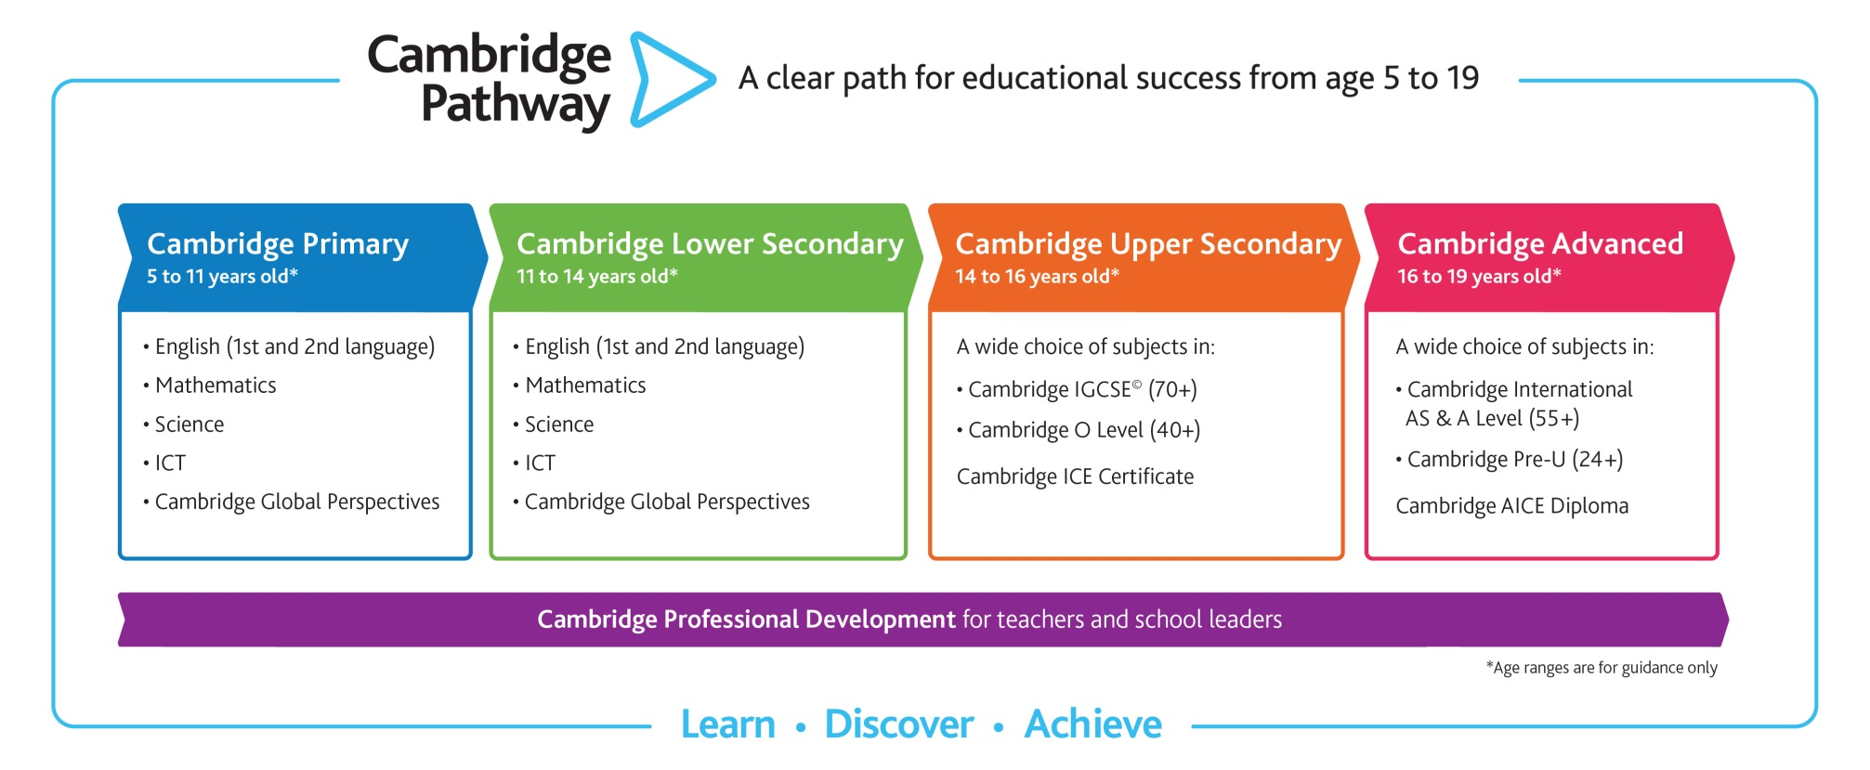
What is the Cambridge Pathway?

Slide 6
Introductory course aims
The aims of this course are to explore and understand:
the syllabus requirements
teaching strategies
the assessment process
the use of assessment documents to inform teaching
Notes:
6

Slide 7
Outline for the day
Today we will consider the following:
the syllabus
knowledge required by learners to access the syllabus
formative assessment strategies
teaching approaches
appropriate challenge for learners

Slide 8
Session 2 – the syllabus
The objective of this session is to ensure that you understand the objectives, content and structure of the syllabus

Slide 9
Activity 1 – quiz
You have 20 minutes for the quiz. Please follow these instructions:
answer all questions
work in pairs
use the syllabus document to help you
ask if there are any words in the quiz or syllabus which you do not understand

Slide 10
Activity 1 – answers
Use these slides to put the answers to the quiz questions
Next answer
And so on …
Answer
Answer

Slide 11
The syllabus
Use these slides to give any additional info you think delegates may need
As this is Introductory training, please do not refer to NEW or CHANGES in the syllabus
Only add a max of four slides

Slide 12
The syllabus
Slide for additional syllabus info

Slide 13
The syllabus
Slide for additional syllabus info

Slide 14
The syllabus
Slide for additional syllabus info

Slide 15
Session 3 – assessing knowledge
The objective of this session is to understand the knowledge required to be successful in this syllabus and how this is assessed

Slide 16
Activity 2 – knowledge and skills
Look at section X of the syllabus
The cards show the knowledge or skills required to be successful
Rank the cards to show how essential this knowledge/skills area is
  cards may be ranked as equal and you can add your own cards

Slide 17
Current ability and knowledge level
Please discuss in groups:
  where you think most learners would have good previous knowledge/skills
  where they would need most support

Slide 18
Break
Please be back in 20 minutes
Refreshments are available

Slide 19
Session 4 – formative uses of assessment
The objective of this session is to identify opportunities to use assessment formatively

Slide 20
Activity 3 – formative use of assessment
Based on an area of the syllabus your learners need support, your task is to create an assessment that can be used formatively. It should:
  focus on assessing the skills or knowledge required for this part of the syllabus
  identify learners’ understanding level of the concepts or skills
  be accessible – the assessment will not tell you anything if the learners cannot complete it
  allow learners to apply their knowledge

Slide 21
Lunch
Please be back in 1 hour

Slide 22
Session 5 – teaching approaches
The objective of this session is to explore a variety of teaching approaches

Slide 23
Activity 4 – teaching approaches
Discuss the teaching approach on the slide you have been given
Choose a topic from the syllabus to apply this method to and plan how you would do this in your classroom
Fill in the KASH analysis form and use this to report back to the other delegates

Slide 24
Flipped learning
Learners are given material – usually online videos and resources – to introduce and/or research the topic before the formal classroom experience begins
This can be done either at home or in the classroom
Resources for learners can be developed in school and/or found online

Slide 25
Flipped learning – example
Use this slide to give a subject-specific example of flipped learning

Slide 26
Enquiry based learning
Learners carry out research (enquiries) into the topic and look at questions and problems. This can be done outside the classroom so ‘flipping’ the learning
The 5 Ws and an H approach may be useful – What, Why, Who, When, Where and How
Resources could include textbooks and the internet
This can be done in collaboration with other learners or with staff
The research tasks are open-ended enabling individual response

Slide 27
Group work 1
In this type of group work it is useful to assign roles. These roles can be:
facilitator
recorder
summariser
presenter

Slide 28
Group work 2
Think, pair, share is a co-operative discussion strategy. It works by:
provoking thinking with a question, prompt or observation
allowing learners to pair up to compare notes
pairs can share their thinking with the rest of the class

Slide 29
Group work 3
Rainbow grouping is where learners work in groups of up to 6 on a topic:
they are given cards so that in each group each learner has a different colour
groups then re-form by colour and learners feedback to their new group

Slide 30
Break
Please be back in 20 minutes
Refreshments are available

Slide 31
Session 6 – resources and activities
The objective of this session is to try a few learning resources and activities and then develop your own examples

Slide 32
Learning resources and activities
Matching puzzles
Follow me cards
Cloze
True/false cards
Taboo

Slide 33
Activity 5 – trying out activities
Have a go at the activities on your table
Discuss how one or more of these could be used in a formative assessment for a topic of your choice

Slide 34
Other teaching ideas
learners create a PowerPoint, Prezi or whiteboard flipchart on a topic
learners create a storyboard for a topic
learners produce a summary of a topic
learners mark and comment on a piece of work generated by the teacher which contains common errors and misconceptions

Slide 35
School Support Hub
All the resources you need to teach Cambridge programmes in one place, including:
  Example candidate responses
  Learner guides
  Past papers
  Schemes of work
Keep up to date with your subject and the global Cambridge community
Find out more:
        www.cambridgeinternational.org/school-support-hub

Slide 36
End of day 1
Thank you for taking part in today’s training.
Please stay behind now if you have any further questions.

